Slide 1
Mystic Music
Blocking

Slide 2
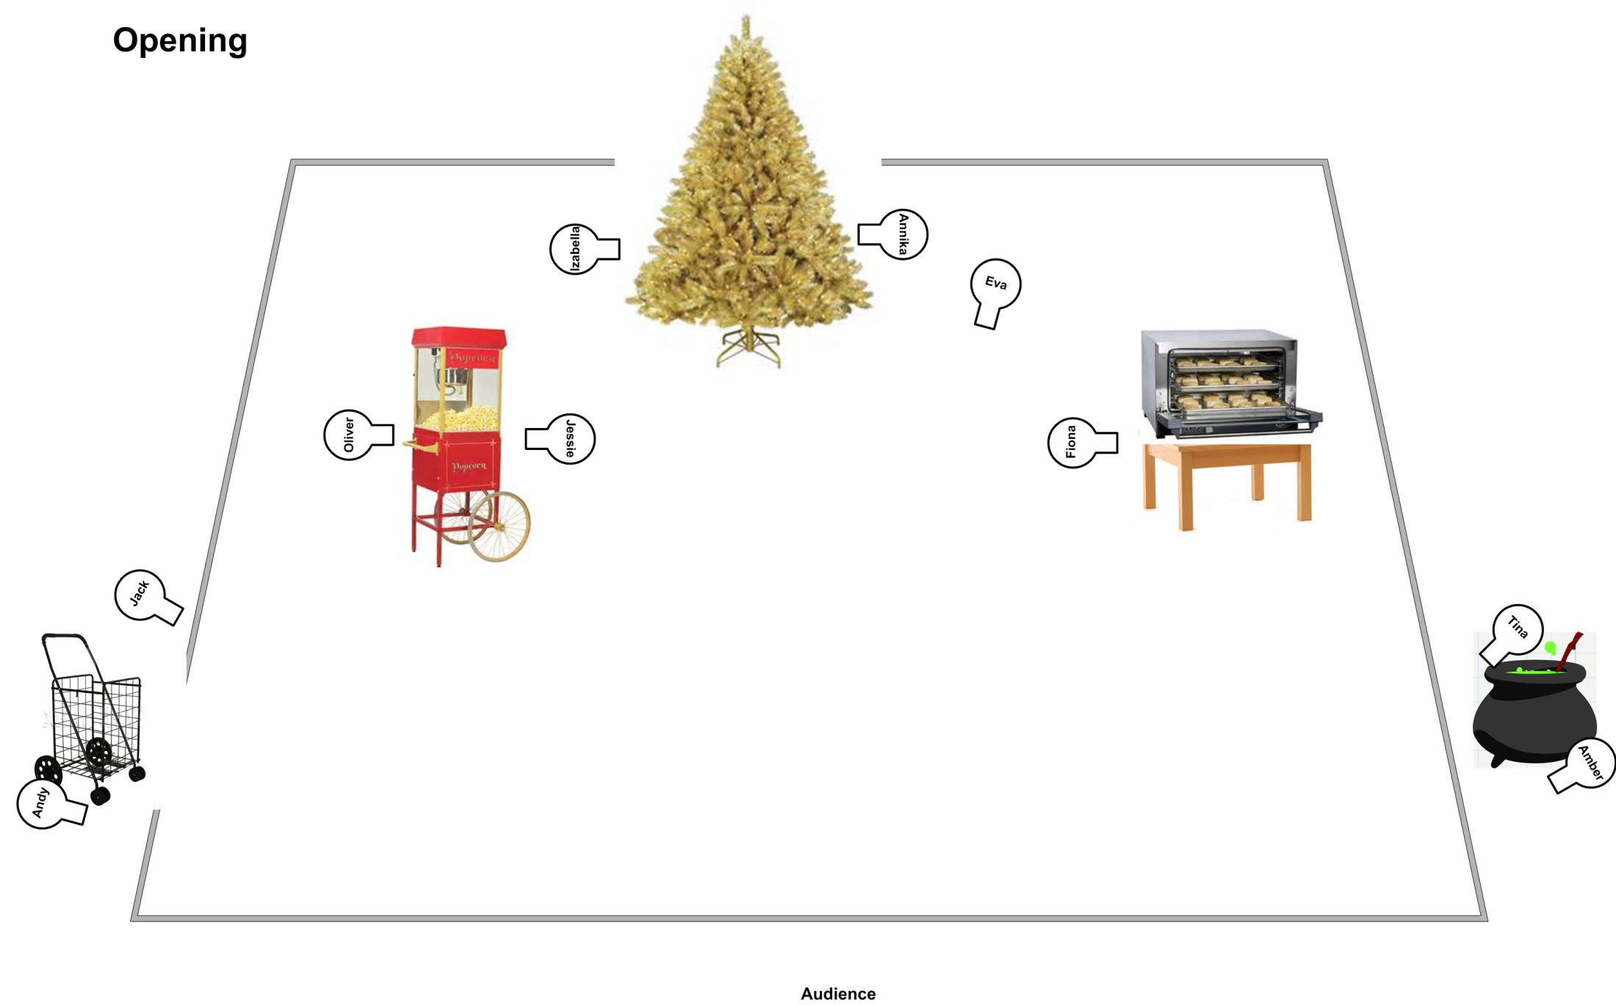

Slide 3
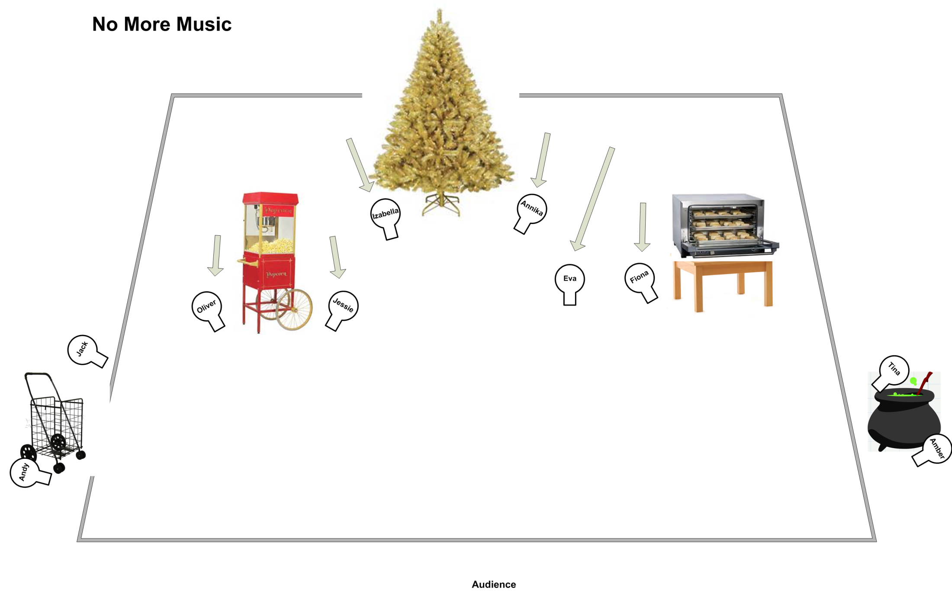

Slide 6
